Slide 1
Buy ,Sell Or Rent Property
A.S.M ASIF UL HASAN
ID:011151205
MD.ASHRAFUL ALAM
ID:011151196
MAHJABEEN MAHBUB SHAMA
ID:011151179

Slide 2
Description:
Administrator can manage State ,City, Area and Category. Administrator can Manage News and View Feedback of Customer. Customer can manage his/her own profile. Seller can upload the information of the property to sale. Customer can Search Area wise Property for buy.

Slide 3
Benchmark Products:
Followings are the most popular benchmark products around the world considered as standards for comparison purpose for our product.
www.propertybazaar.com
www.primelocation.com
www.housing.com
www.magicbricks.com
www.onthemarket.com

Slide 4
Facilities provided by these bench mark products:
We can buy or rent a property.
Admin, buyers and sellers only can visit.
Buyers select the amount range.
Buyers find the property in suitable place.
Seller can advertise their property.
They ensure the original owner of the property.

Slide 5
Features:
Home/Apartment/Land for Sale or Buy or Rent
Agent and Brokers
Administrator can manage state ,city ,area and category.
Seller can Upload the information of the property
Customer can search area wise property.

Slide 6
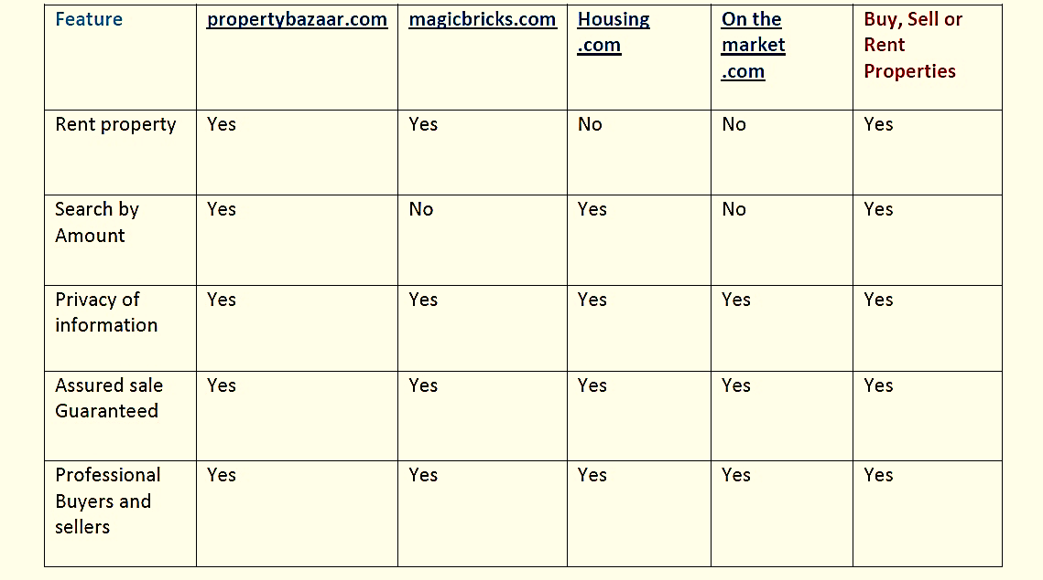
Comparison:

Slide 7
Conclusion : In the survey the average feasibility rating is 4+ out of 5.Which is greater than 3.So we can say that our project is feasible according to current market.
Feasibility Studies:
Question | Response
1.If You registered yourself on the website you can buy as well as sale or rent properties through this. | 18
2.Here you can search for various properties such as House,Flat, land and Shops as per your requirements. | 18
3.You can view the details of each and every property. | 17
4.If you are interested then you can contact to the owner of the property. | 18
5.If you want to sell or rent your property then you can upload the description,price, image etc of the property. | 18
6.Here you can search properties by selecting the category Division,District,Area name. | 18
7.You can also find the latest update on property in the news section. | 18
8.You can send feedback to the administrator If you face any kind problem. | 18
Average Rating for Q1= | 4.111111
Average Rating for Q2= | 4.5
Average Rating for Q3= | 4.529412
Average Rating for Q4= | 4.277778
Average Rating for Q5= | 4.444444
Average Rating for Q6= | 4.5
Average Rating for Q7= | 4.333333
Average Rating for Q8= | 4.388889
So, Average Rating for All Question | 4.385621
Question | Response
1.If You registered yourself on the website you can buy as well as sale or rent properties through this. | 18
2.Here you can search for various properties such as House,Flat, land and Shops as per your requirements. | 18
3.You can view the details of each and every property. | 17
4.If you are interested then you can contact to the owner of the property. | 18
5.If you want to sell or rent your property then you can upload the description,price, image etc of the property. | 18
6.Here you can search properties by selecting the category Division,District,Area name. | 18
7.You can also find the latest update on property in the news section. | 18
8.You can send feedback to the administrator If you face any kind problem. | 18
Average Rating for Q1= | 4.111111
Average Rating for Q2= | 4.5
Average Rating for Q3= | 4.529412
Average Rating for Q4= | 4.277778
Average Rating for Q5= | 4.444444
Average Rating for Q6= | 4.5
Average Rating for Q7= | 4.333333
Average Rating for Q8= | 4.388889
So,Average Rating for All Question | 4.385621

Slide 8
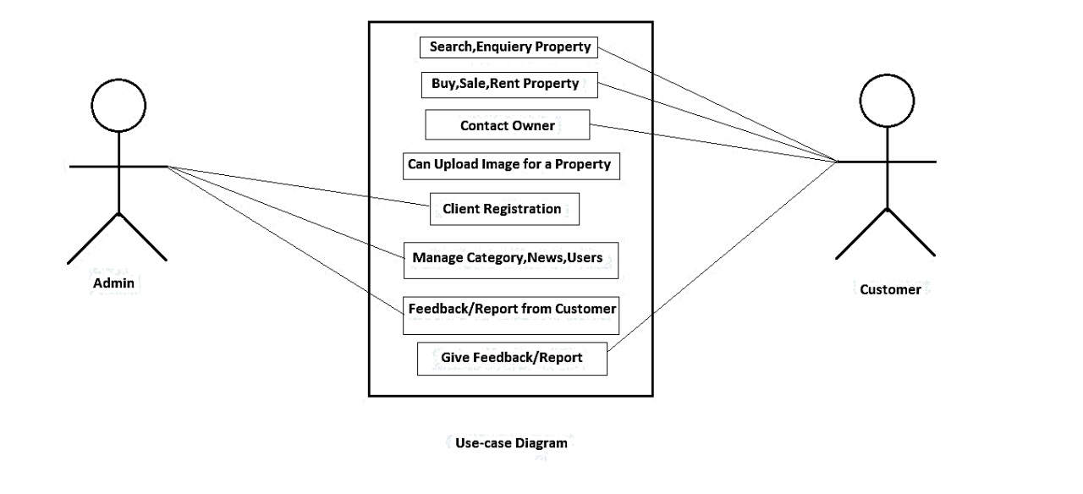
Use-Case Diagram:

Slide 9
Use Case Descriptive form:
Use Case 01: Buy a Property
Primary Actor: Customer
Stakeholders and interests:
1.Customer: Wants to get successfully buy the product.
2.Seller: Wants to get successfully sell the product.
3.Admin: Needs to make sure that both the customer and seller has
the username and password in order to log-in into the system.
Pre condition:
1.The Customer should be registered user.
2. Customer should know the username and password for logging in.

Slide 10
Use Case Descriptive form:
Post Conditions:
The information remains even when the customer/seller logs out.
The changes are made in the database.
The Customer can see the news of new property.
Main Success Scenario
1. Customer goes to the website
2. Customer logs into the system using the username and password
3. Customer can search and view the available property.
4. Customer finds the desired property and check information and contact the owner of the property.

Slide 11
Use Case Descriptive form:
Alternate Scenario:
*a. The system may not respond
Solution: Wait for the system to respond
4a. Customer may not contact to the owner
Solution: Can report to admin
Issues:
If username or password is not correct. Error message will be shown.

Slide 12
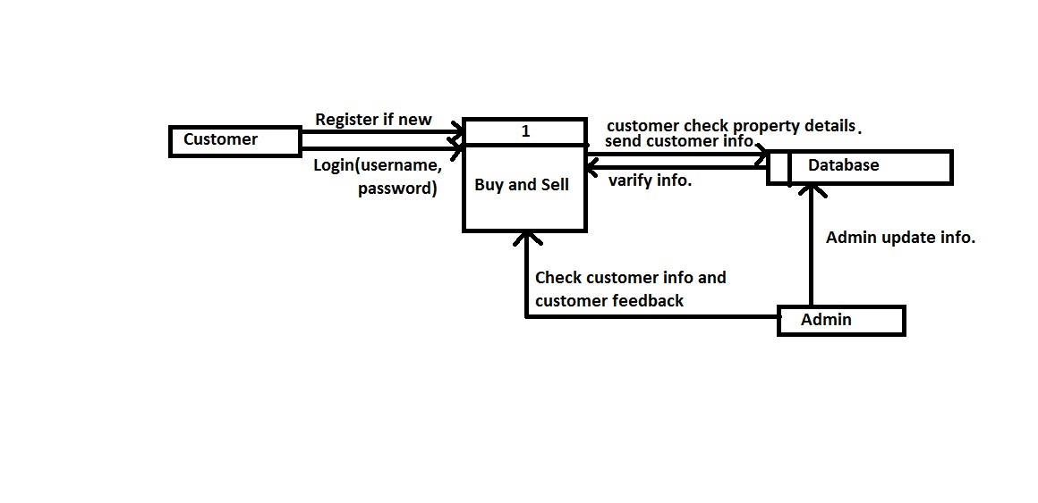
Data Flow Diagram:

Slide 13
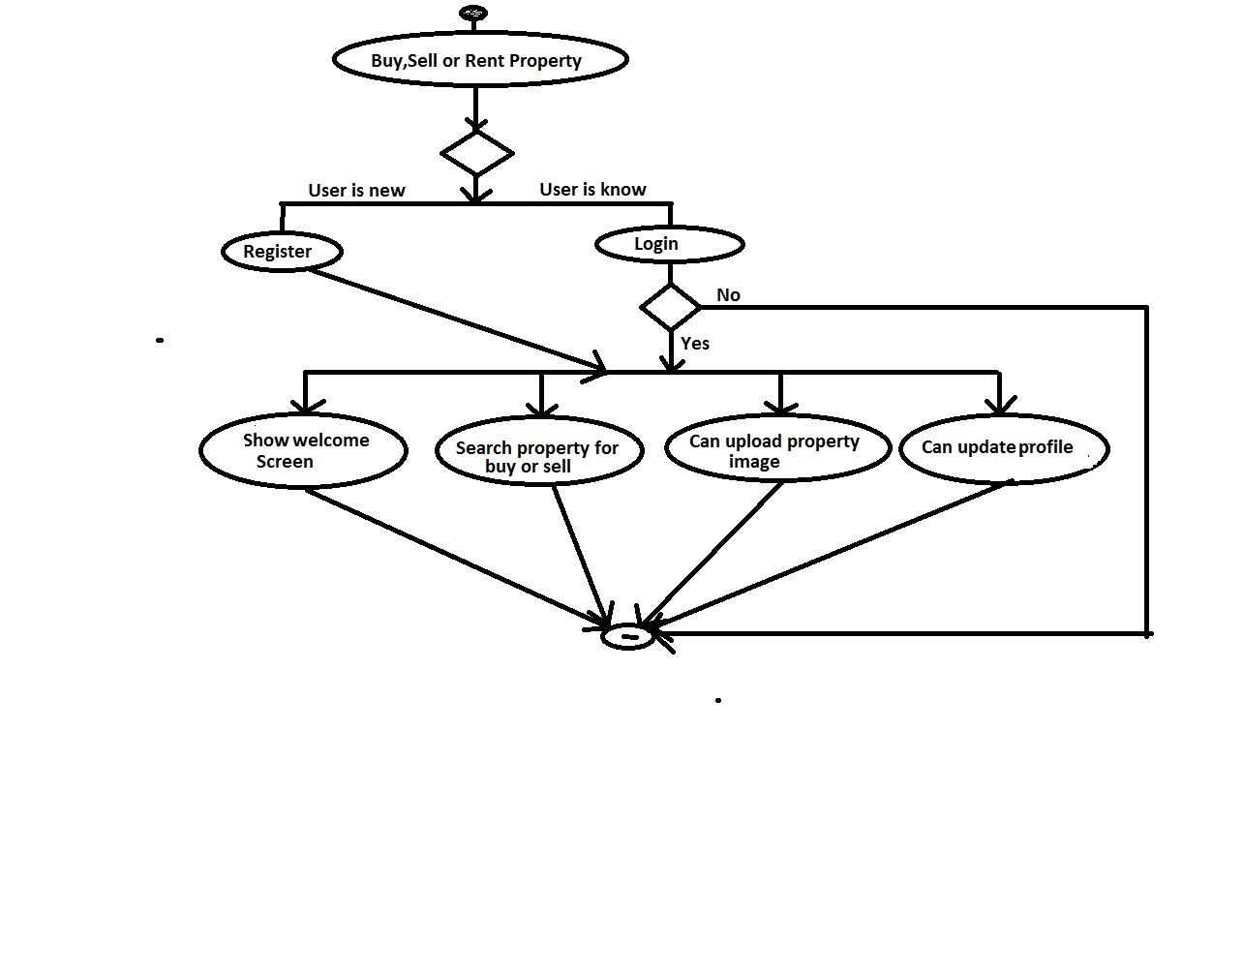
Activity Diagram:(Customer)

Slide 14
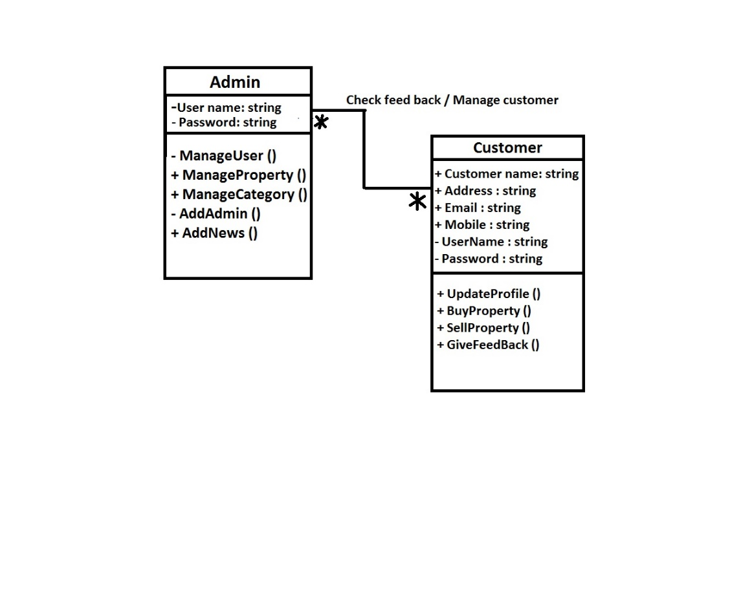
Class Diagram:

Slide 15
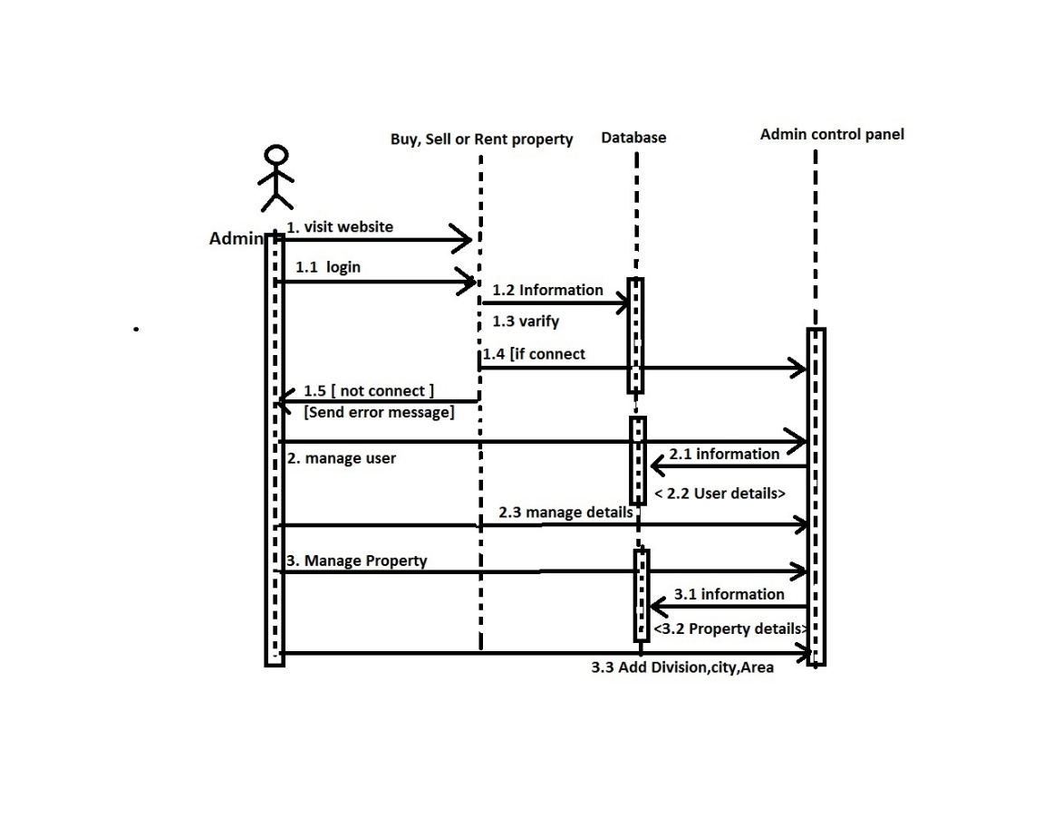
Sequence Diagram:

Slide 16
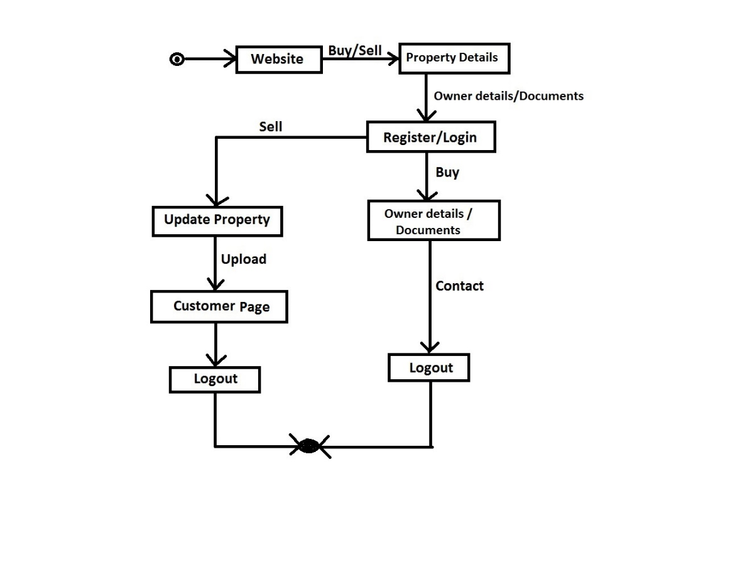
State Diagram:

Slide 17
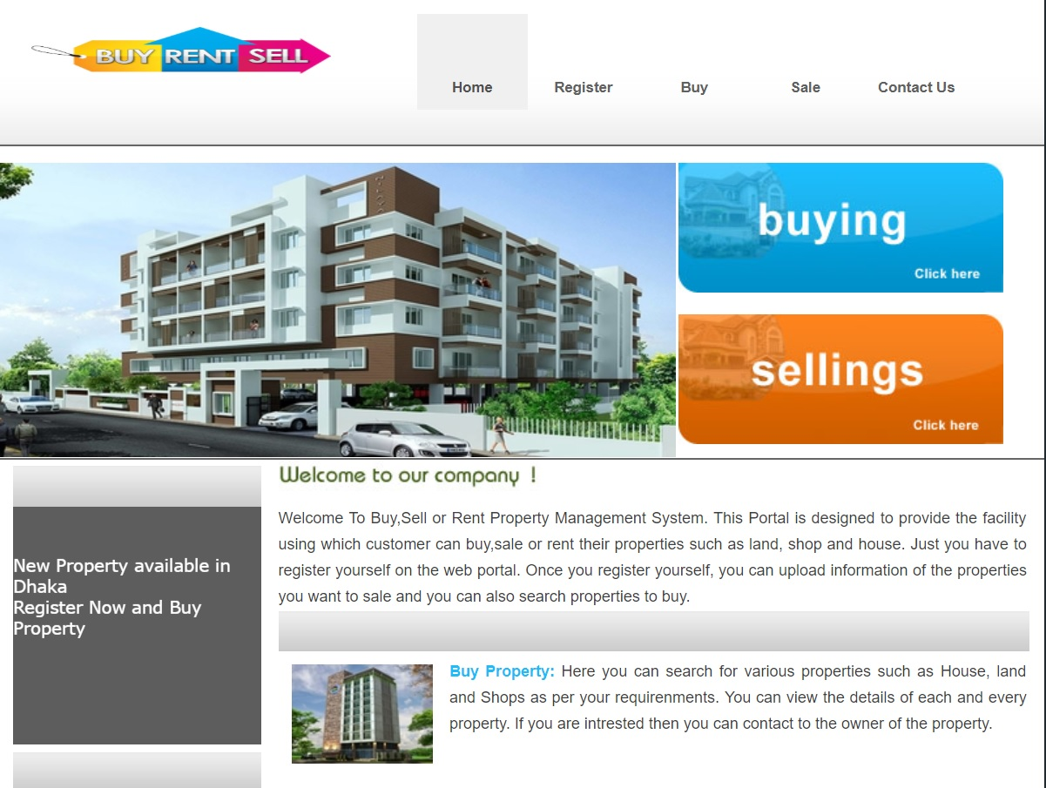
Brief Demo of the Project: Home page:

Slide 18
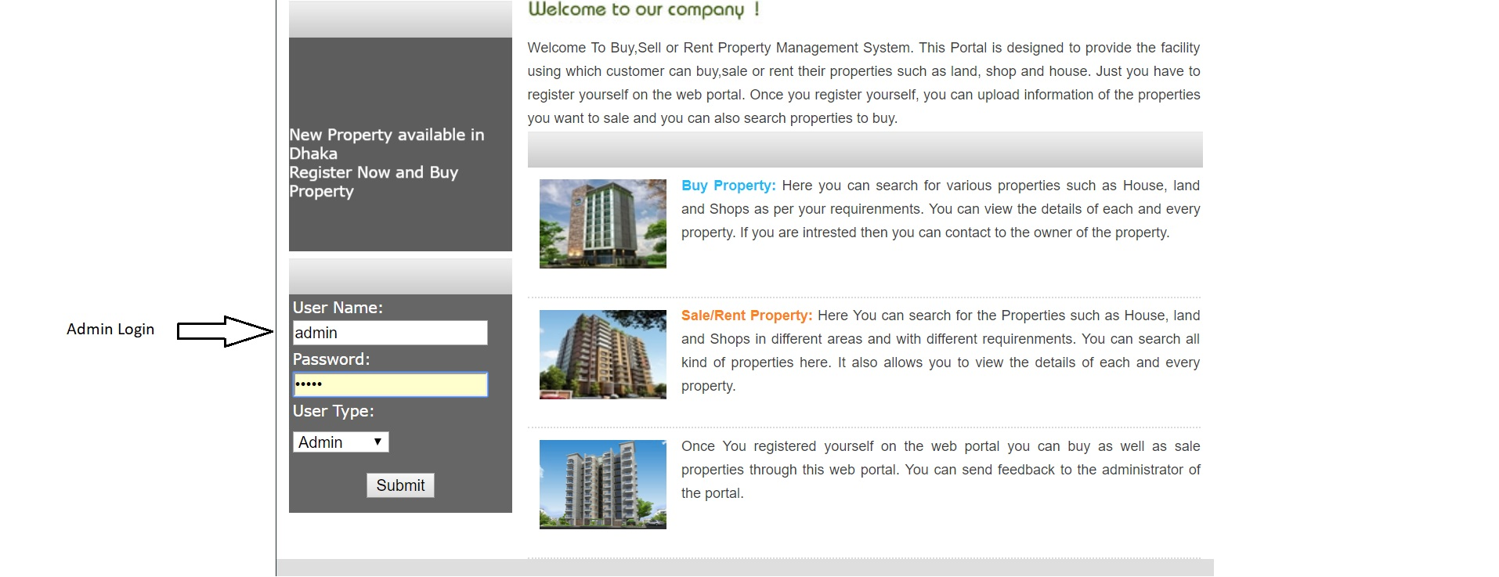
Admin Login

Slide 19
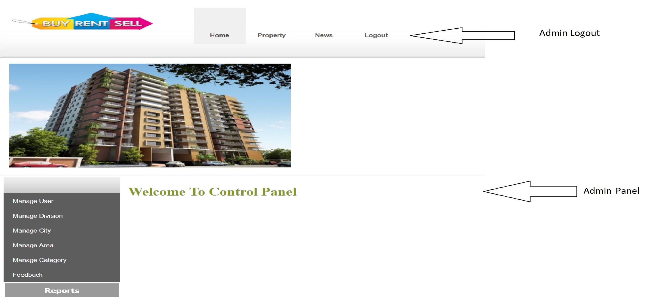
Admin Panel:

Slide 20
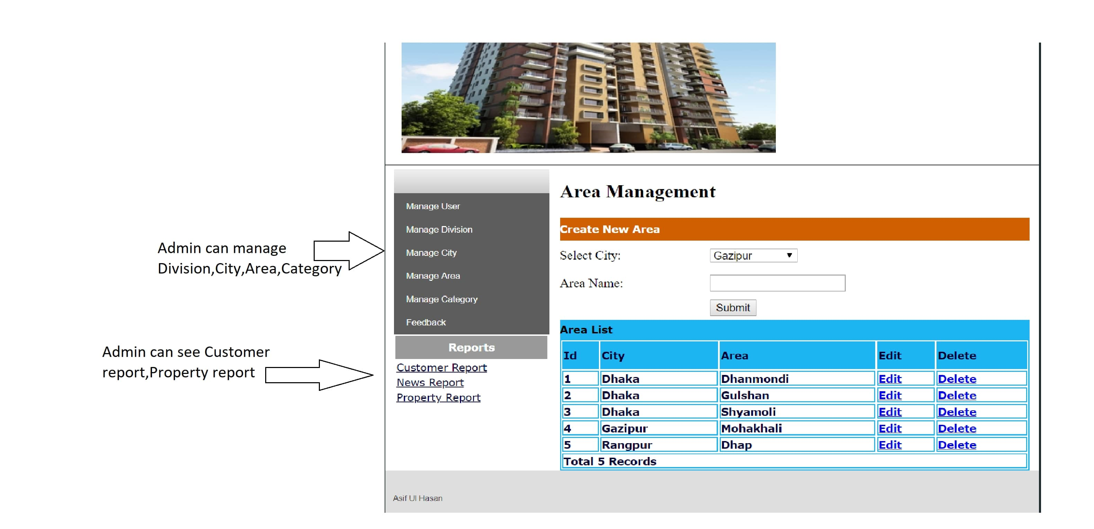

Slide 21
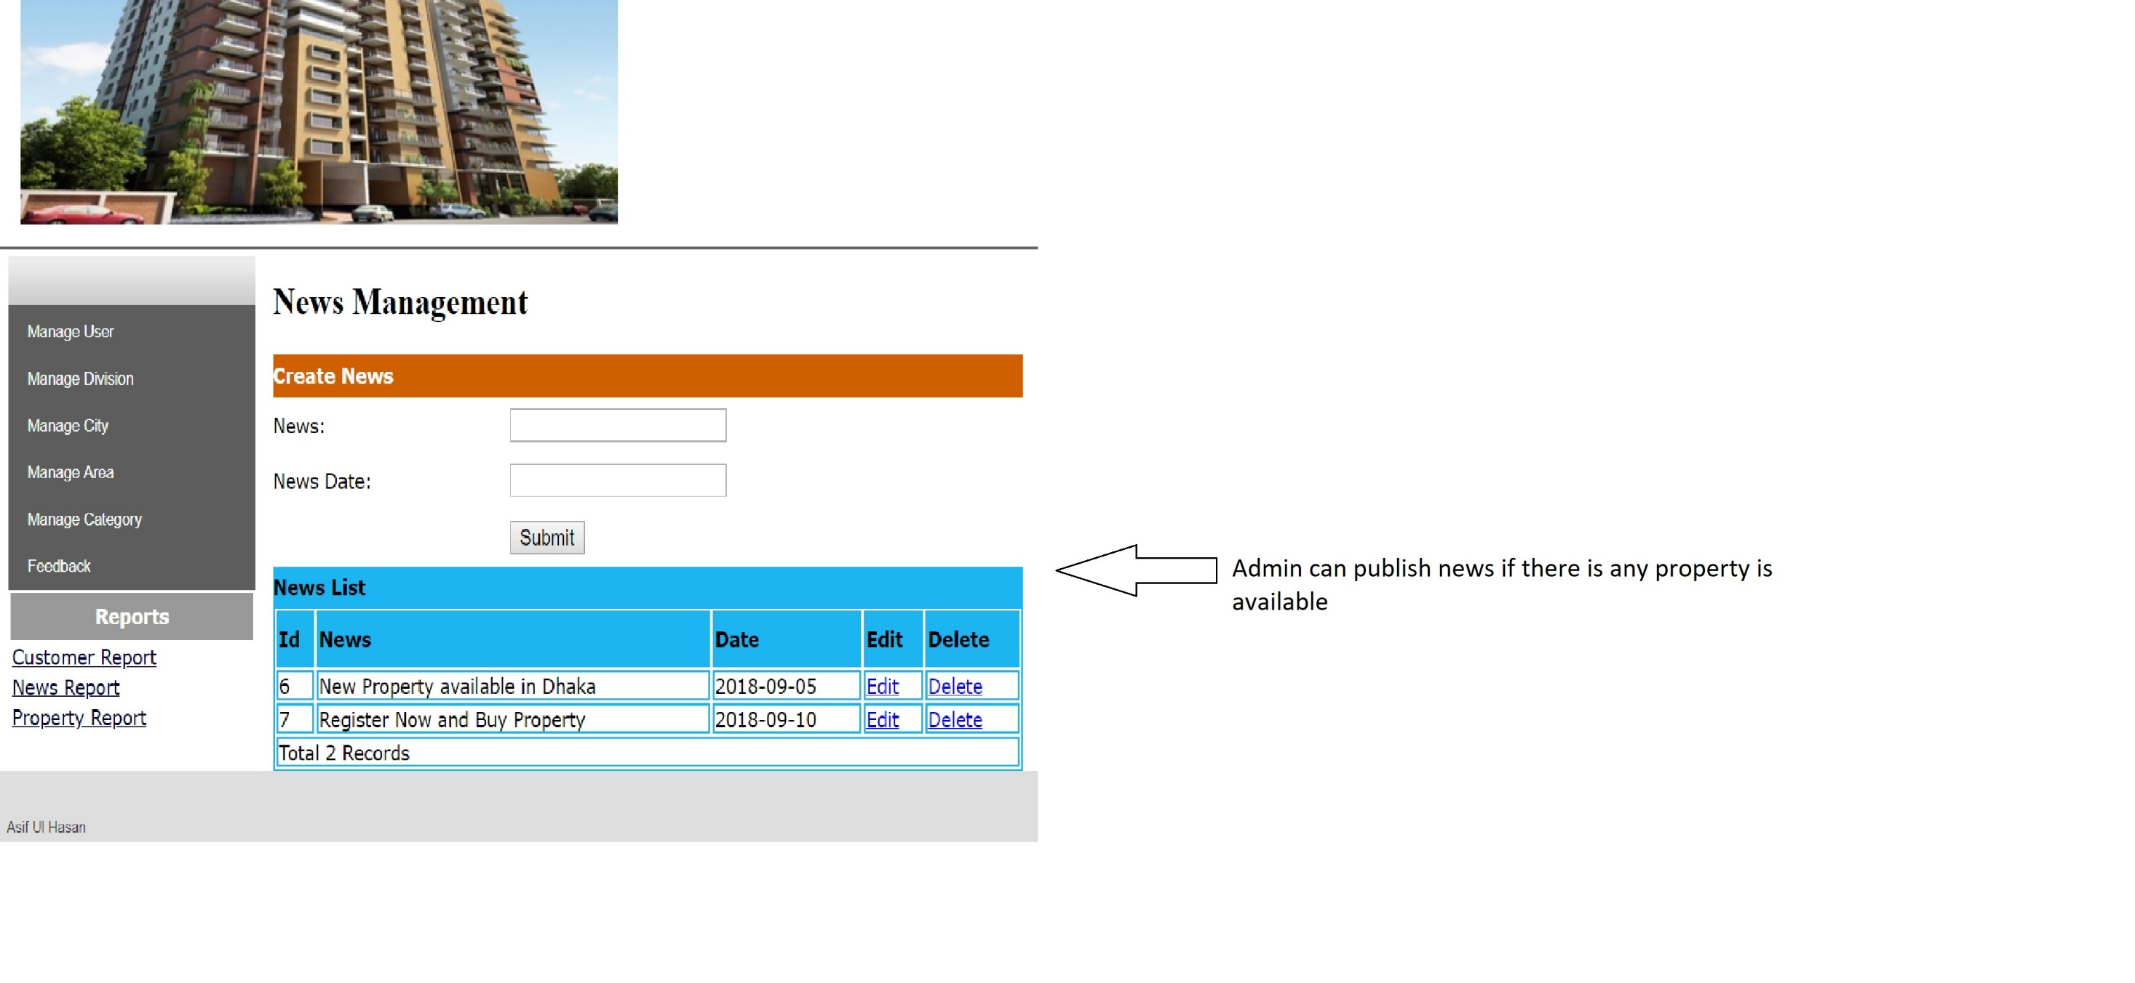

Slide 22
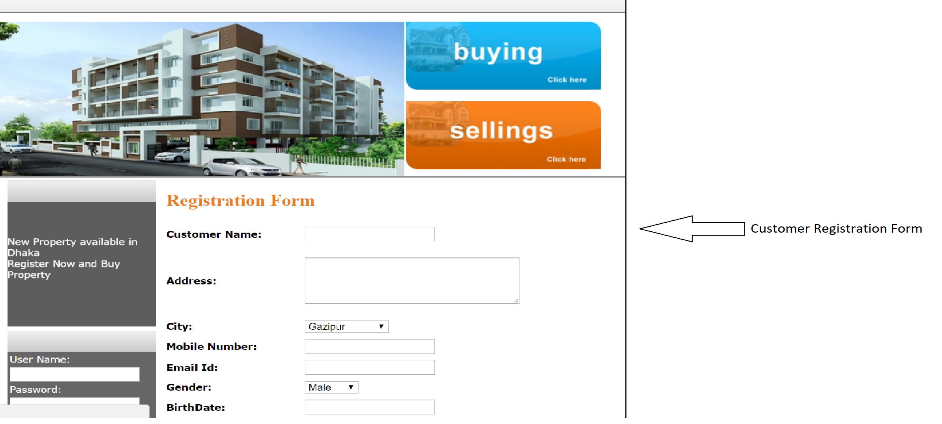

Slide 23
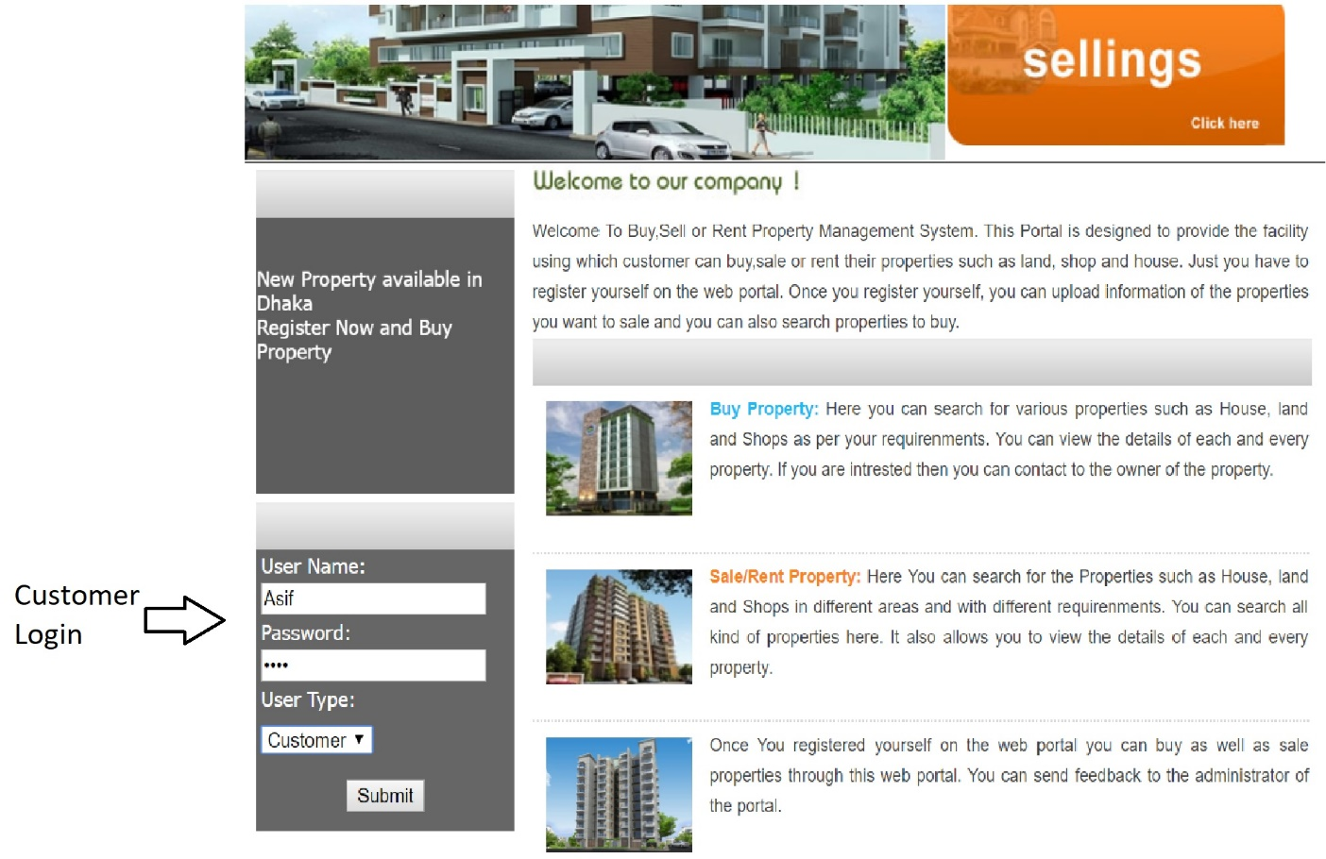

Slide 24
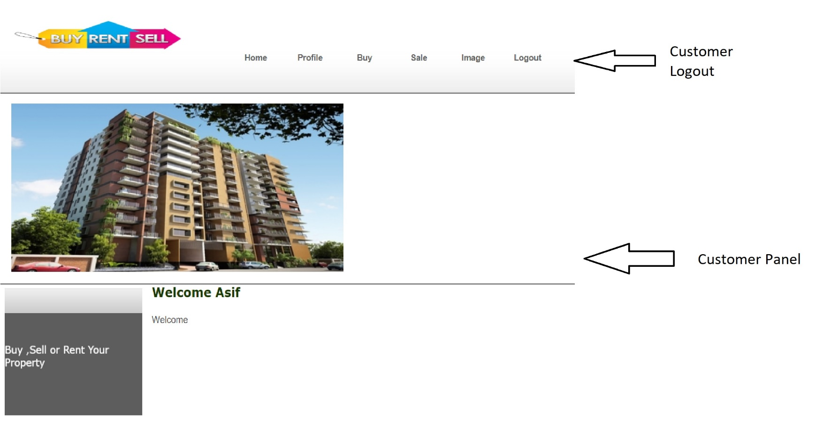

Slide 25
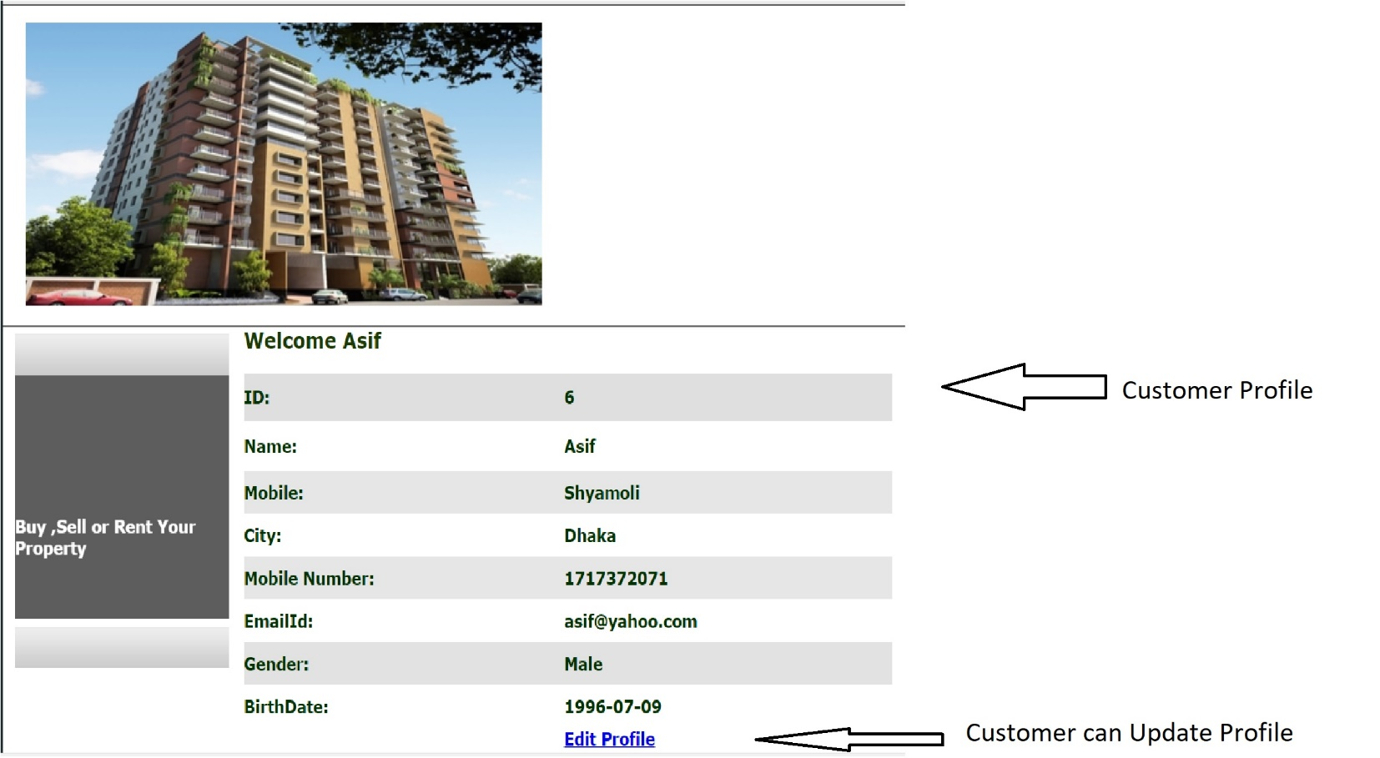

Slide 26
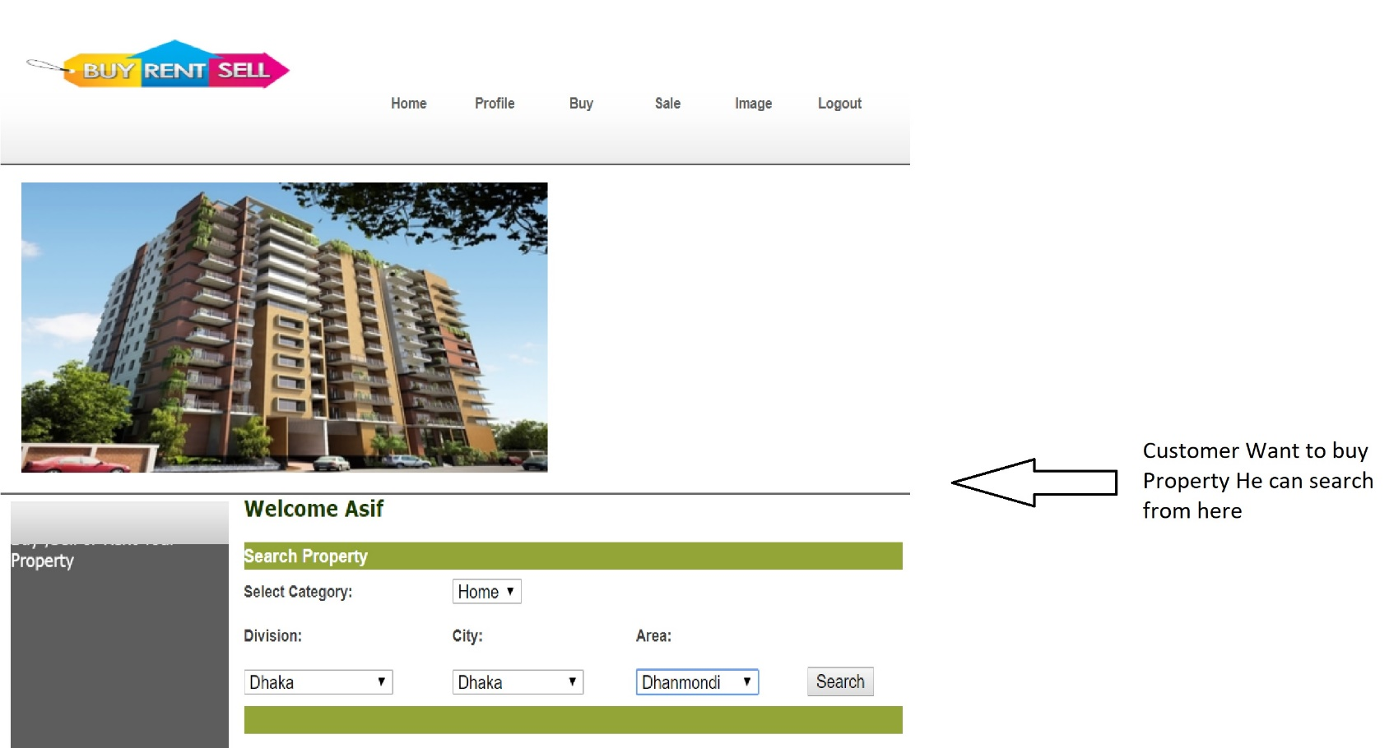

Slide 27
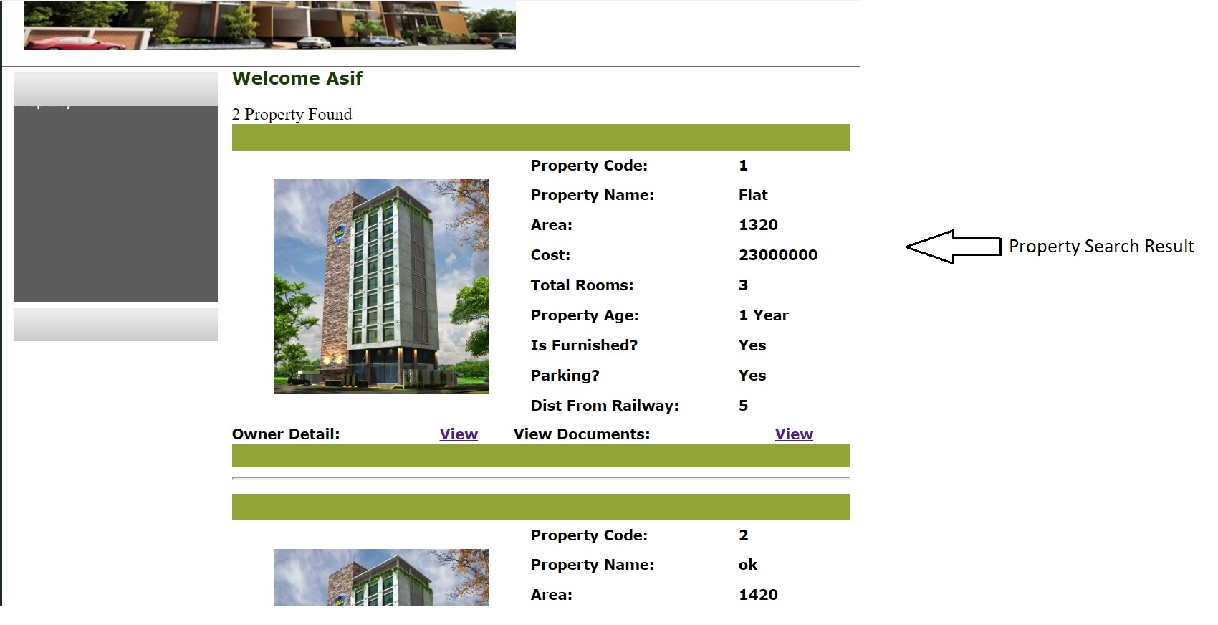

Slide 28
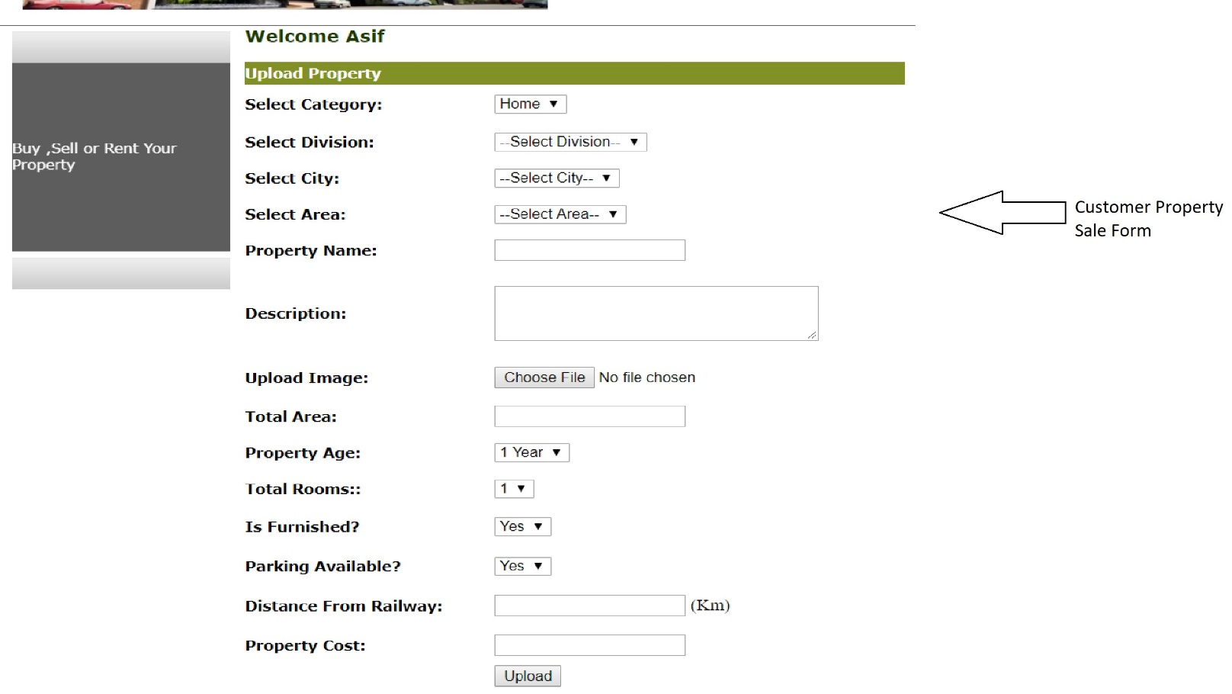

Slide 29
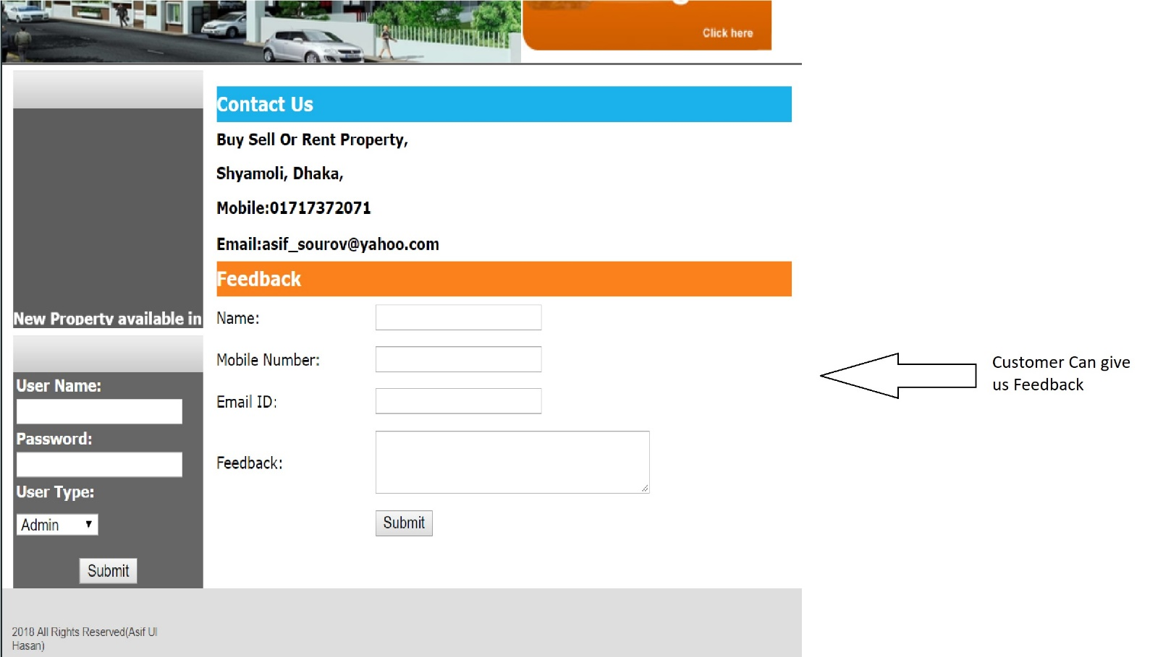

Slide 30
Thank You

